Slide 1
Hibernate Queries
Design by: DieuNT1

Slide 2
Lesson Objectives
Understand the Native Query and @NamedNativeQuery.
Understand the Proxy Object in Hibernate.
Able to distinguish get() and load() method.
1
3
5
2
Understand the queries be used in hibernate.
4
Able to use Hibernate Query Language.

Slide 3
Agenda
Queries Introduction
Native Query
Hibernate Query Language
Hibernate Named Query
Proxy Object
get() vs load() method
Notes:
Overview: What is hibernate & high level architecture

Slide 4
Queries Introduction
Section 01

Slide 5

Hibernate Query Language
The Hibernate Query Language (HQL) and Java Persistence Query Language (JPQL) are both object model focused query languages similar in nature to SQL.
JPQL is a heavily-inspired-by subset of HQL.
A JPQL query is always a valid HQL query, however the reverse is not true.
Both HQL and JPQL are non-type-safe ways to perform query operations. Criteria queries offer a type-safe approach to querying.

Slide 6

Navite Query
You may also express queries in the native SQL dialect of your database.
This is useful if you want to utilize database specific features such as query hints or the CONNECT BY option in Oracle.
It also provides a clean migration path from a direct SQL/JDBC based application to Hibernate.
Note that Hibernate allows you to specify handwritten SQL (including stored procedures) for all create, update, delete, and load operations.

Slide 7
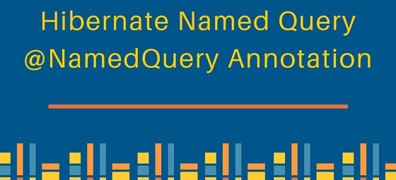
Hibernate Named Query
A named query is a JPQL or Navite SQL expression with a predefined unchangeable query string.
You can define a named query either in hibernate mapping file or in an entity class.
The named queries in hibernate is a technique to group the HQL statements in a single location, and lately refer them by some name whenever the need to use them.
It helps largely in code cleanup because these HQL statements are no longer scattered in whole code.

Slide 8
NATIVE Query
Section 02

Slide 9
Native Query
Hibernate allows us to execute the native SQL queries for all create, update, delete and retrieve operations.
In hibernate, you can execute your native SQL queries using the Session.createNativeQuery() method..
Hibernate SQL query is not the recommended approach because we loose benefits related to hibernate association and hibernate first level cache.
Query object:
Syntax to create the Query object and execute it:
SQLQuery Methods:
List<Object> list() method: returns the list of Object array, we need to explicitly parse them to double, long etc.
addEntity() and addJoin() methods to fetch the data from associated table using tables join
Query<Employees> query = session.createNativeQuery(String query);
Notes:
Mục đích: Hibernate SQL Query is very handy when we have to execute database vendor specific queries that are not supported by Hibernate API. For example query hints or the CONNECT keyword in Oracle Database.
➔ Sử dụng cho các Database vendor mà không hỗ trợ Hibernate API.

Slide 10
Native Query
Example 1: using addEntity()
Results:
@Override
public List<Jobs> findAll() throws Exception {
Session session = null;
try {
session = HibernateUtils.getSessionFactory().openSession();
Query<Jobs> query = session
.createNativeQuery("SELECT * FROM dbo.Jobs")
.addEntity(Jobs.class);
return query.list();
} finally {
if (session != null) {
session.close();
}
}
}
[Jobs [jobId=J01, jobTitle=Java Dev1, minSalary=1000.0, maxSalary=2000.0],
Jobs [jobId=J02, jobTitle=Java Dev2, minSalary=1200.0, maxSalary=2200.0],
Jobs [jobId=J03, jobTitle=Java Dev3, minSalary=1400.0, maxSalary=3200.0]]
Notes:
Mục đích: Hibernate SQL Query is very handy when we have to execute database vendor specific queries that are not supported by Hibernate API. For example query hints or the CONNECT keyword in Oracle Database.
➔ Sử dụng cho các Database vendor mà không hỗ trợ Hibernate API.

Slide 11
Native Query
Example 2: native query with the conditions/parameters
Results:
@Override
public List<Jobs> findByNameAndSalary(String title, double salary)
throws Exception {
Session session = null;
try {
session = HibernateUtils.getSessionFactory().openSession();
Query query = session.createNativeQuery(
"SELECT * FROM dbo.Jobs j WHERE j.job_title LIKE :title "
+ "AND j.min_salary <= :salary AND j.max_salary >= :salary")
.addEntity(Jobs.class);
query.setParameter("title", "%" + title + "%");
query.setParameter("salary", salary);
return query.list();
} finally {
if (session != null) {
session.close();
}
}
}
[Jobs [jobId=J01, jobTitle=Java Dev1, minSalary=1000.0, maxSalary=2000.0]]
Notes:
Mục đích: Hibernate SQL Query is very handy when we have to execute database vendor specific queries that are not supported by Hibernate API. For example query hints or the CONNECT keyword in Oracle Database.
➔ Sử dụng cho các Database vendor mà không hỗ trợ Hibernate API.

Slide 12
Native Query
Example 3: addEntity(), addJoin()
@Override
public List<Object[]> findAll() throws Exception {
Session session = null;
try {
session = HibernateUtils.getSessionFactory().openSession();
Query query = session.createNativeQuery(
"SELECT j.*, e.* FROM dbo.Jobs j JOIN dbo.Employees e "
+ "ON j.job_id = e.job_id")
.addEntity("j", Jobs.class)
.addJoin("e", "j.employees");
List<Object[]> jobs = query.list();
return jobs;
} finally {
if (session != null) {
session.close();
}
}
}
Notes:
Mục đích: Hibernate SQL Query is very handy when we have to execute database vendor specific queries that are not supported by Hibernate API. For example query hints or the CONNECT keyword in Oracle Database.
➔ Sử dụng cho các Database vendor mà không hỗ trợ Hibernate API.

Slide 13
Native Query
@Test
void testFindAll() throws Exception {
List<Object[]> jobs = jobDao.findAll();
for (Object[] object : jobs) {
Jobs job = (Jobs) object[0];
System.out.println(job);
for (Employees employee : job.getEmployees()) {
System.out.println(employee);
}
}
}
Results:
Jobs [jobId=J01, jobTitle=Java Dev1, minSalary=1000.0, maxSalary=2000.0]
Employees [employeeId=5, first_name=Nguyen, last_name=Minh Thanh, email=thanh@fsoft.com.vn, phoneNumber=0988777111,
hireDate=1999-01-01, salary=1000.0, commissionPct=1.1]
Employees [employeeId=1, first_name=Nguyen, last_name=Quang Anh, email=anhnd22@fsoft.com.vn, phoneNumber=0988777666,
hireDate=2019-01-01, salary=1000.0, commissionPct=1.1]
Jobs [jobId=J01, jobTitle=Java Dev1, minSalary=1000.0, maxSalary=2000.0]
Employees [employeeId=5, first_name=Nguyen, last_name=Minh Thanh, email=thanh@fsoft.com.vn, phoneNumber=0988777111,
hireDate=1999-01-01, salary=1000.0, commissionPct=1.1]
Employees [employeeId=1, first_name=Nguyen, last_name=Quang Anh, email=anhnd22@fsoft.com.vn, phoneNumber=0988777666,
hireDate=2019-01-01, salary=1000.0, commissionPct=1.1]
Jobs [jobId=J02, jobTitle=Java Dev2, minSalary=1200.0, maxSalary=2200.0]
Employees [employeeId=7, first_name=Hoang, last_name=Van Liem, email=Liem@fsoft.com.vn, phoneNumber=0988777112,
hireDate=1999-01-01, salary=1000.0, commissionPct=1.1]

Slide 14
Native Query
Using @NamedNativeQuery and @NamedNativeQueries Annotations.
Syntax:
@Entity
@Table(name = "Employees", schema = "dbo", indexes = {
@Index(columnList = "first_name, last_name", name = "IDX_EMP_NAME") })
@NamedNativeQueries({
@NamedNativeQuery(name = "FIND_EMP_BY_JOB", query = "SELECT e.* "
+ "FROM dbo.Employees e JOIN dbo.Jobs j ON e.job_id = j.job_id "
+ "AND j.job_id LIKE :jobTitle", resultClass = Employees.class),
@NamedNativeQuery(name = "EMP_FIND_ALL",
query = "SELECT * FROM dbo.Employees",
resultClass = Employees.class)
@NamedNativeQuery(name = "COUNT_EMP",
query = "SELECT AVG(e.salary) FROM dbo.Employees e "
+ "WHERE e.job_id = :jobId")})
public class Employees {
}

Slide 15
Native Query
The session.createNamedQuery(String name) method:
@Override
public List<Employees> findByJob(String jobTile) {
Session session = null;
try {
session = HibernateUtils.getSessionFactory().openSession();
Query<Employees> query = session
.createNamedQuery("FIND_EMP_BY_JOB");
query.setParameter("jobTitle", "%" + jobTile + "%");
return query.list();
} finally {
if (session != null) {
session.close();
}
}
}

Slide 16
Native Query
The query.getSingleResult() method:
@Override
public double countByJob(String jobId) {
Session session = null;
try {
session = HibernateUtils.getSessionFactory().openSession();
Query query = session.createNamedQuery("COUNT_EMP");
query.setParameter("jobId", jobId);
return (double) query.getSingleResult();
} finally {
if (session != null) {
session.close();
}
}
}

Slide 17
Hibernate Query Language
Section 03
Notes:
Link docs: https://docs.jboss.org/hibernate/orm/5.2/userguide/html_single/Hibernate_User_Guide.html#hql-group-by

Slide 18
Hibernate Query Language (HQL)
Syntax is quite similar to database SQL language.
Uses class name instead of table name, and property names instead of column name:
SQL similarity: HQL’s syntax is very similar to standard SQL.
Fully object-oriented: HQL doesn’t use real names of table and columns. It uses class and property names instead. HQL can understand inheritance, polymorphism and association.
Case-insensitive for keywords: Like SQL, keywords in HQL are case-insensitive. That means SELECT, select or Select are the same.
Case-sensitive for Java classes and properties: HQL considers case-sensitive names for Java classes and their properties, meaning Person and person are two different objects.

Slide 19
Execute HQL in Hibernate
Write your HQL:
Create a Query from the Session:
Set parameter (if need):
Execute the query: depending on the type of the query (listing or update), an appropriate method is used:
For a listing query (SELECT):
For an update query (INSERT, UPDATE, DELETE):
String hql = "FROM Projects WHERE startDate >= :startDate";
Query query = session.createQuery(hql);
query.setParameter("startDate", startDate);
List listResult = query.list();
int rowsAffected = query.executeUpdate();

Slide 20
Execute HQL in Hibernate
Extract result returned from the query: depending of the type of the query, Hibernate returns different type of result set.
Select query on a mapped object returns a list of those objects.
Join query returns a list of arrays of Objects which are aggregate of columns of the joined tables. This also applies for queries using aggregate functions (count, sum, avg, etc).
Join Query, HQL supports the following join types (similar to SQL):
INNER JOIN (can be abbreviated as JOIN).
LEFT OUTER JOIN (can be abbreviated as LEFT JOIN).
RIGHT OUTER JOIN (can be abbreviated as RIGHT JOIN).
FULL JOIN

Slide 21
Execute HQL in Hibernate
Example 1: Join query
public List<Object[]> findPublisherBook() {
Session session = null;
try {
session = HibernateUtils.getSessionFactory().openSession();
String joinQuery = "FROM Publisher p INNER JOIN p.publisherBook pb";
Query quey = session.createQuery(joinQuery);
return quey.list();
} finally {
if (session != null) {
session.close();
}
}
}

Slide 22
Execute HQL in Hibernate
Example 1: Join query
Results:
@Test
void testFindPublisherBook() {
List<Object[]> objects = publisherDao.findPublisherBook();
for (Object[] object : objects) {
System.out.println((Publisher) object[0]);
System.out.println((PublisherBook) object[1]);
}
}
Publisher [publisherId=1, name=NXB GD, phone=0979867234]
PublisherBook [id=PublisherBookId [publisherId=1, bookId=1], format=ABC]

Slide 23
Execute HQL in Hibernate
Example 2: Join query
public List<Object[]> findPublisherBook() {
Session session = null;
try {
session = HibernateUtils.getSessionFactory().openSession();
String joinQuery = "FROM Publisher p JOIN p.publisherBook pb "
+ "JOIN pb.book b ";
// The same as
// "FROM Publisher p INNER JOIN p.publisherBook pb "
// + "ON p.publisherId = pb.publisher.publisherId "
// + "INNER JOIN Book b "
// + "ON b.bookId = pb.book.bookId";
Query quey = session.createQuery(joinQuery);
return quey.list();
} finally {
if (session != null) {
session.close();
}
}
}

Slide 24
Execute HQL in Hibernate
Example 2: Join query
Results:
Publisher [publisherId=1, name=NXB GD, phone=0979867234]
PublisherBook [id=PublisherBookId [publisherId=1, bookId=1], format=ABC]
Book [bookId=1, title=Java SE, year=2020, version=1.0]

Slide 25
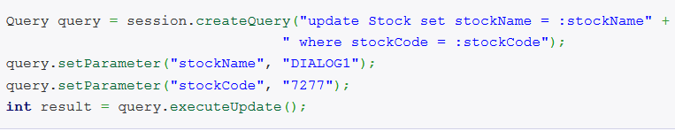
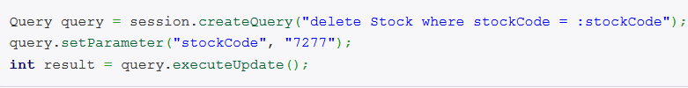
Hibernate Query Language
Example 2:
Update a stock name to “DIALOG1″ where stock code is “7277″
Delete a stock where stock code is “7277″

Slide 26
Hibernate Query Language
Example 3: Sort Query
@Override
public List<Projects> searching(LocalDate startDate) throws Exception {
Session session = null;
try {
session = HibernateUtils.getSessionFactory().openSession();
String hql = "FROM Projects WHERE startDate >= :startDate “
+ "ORDER BY completedOn DESC";
Query<Projects> query = session.createQuery(hql);
query.setParameter("startDate", startDate);
return query.list();
} finally {
if (session != null) {
session.close();
}
}
}

Slide 27
Hibernate Query Language
Example 4: Group By
String hql = "SELECT SUM(p.price), p.category.name "
+ "FROM Product p GROUP BY category";
Query query = session.createQuery(hql);
List<Object[]> listResult = query.list();
for (Object[] aRow : listResult) {
Double sum = (Double) aRow[0];
String category = (String) aRow[1];
System.out.println(category + " - " + sum);
}

Slide 28
Hibernate Query Language
Example 5: Pagination Query
To return a subset of a result set, the Query interface has two methods for limiting the result set:
setFirstResult(intfirstResult): sets the first row to retrieve.
setMaxResults(intmaxResults): sets the maximum number of rows to retrieve.
Query query = session.createQuery("FROM Employees");
query.setFirstResult(0);
query.setMaxResults(10);
return query.list();

Slide 29
Hibernate Query Language
Example 6: Using Aggregate Functions
HQL supports the following aggregate functions:
avg(…), sum(…), min(…), max(…)
count(*)
count(…), count(distinct…), count(all…)
String hql = "SELECT COUNT(jobTitle) FROM Jobs";
Query query = session.createQuery(hql);
List listResult = query.list();
Number number = (Number) listResult.get(0);
System.out.println(number.intValue());

Slide 30
Named Query
The hibernate named query is way to use any query by some meaningful name. It is like using alias names.
So that application programmer need not to scatter queries to all the java code.
There are two ways to define the named query in hibernate:
by annotation
by mapping file
Notes:
Hibernate provide a createSQLQuery method to let you call your native SQL statement directly.

Slide 31
Named Query (cont)
Named Query by Annotation:
@NameQueries: is used to define the multiple named queries.
@NameQuery: is used to define the single named query.
@NamedQueries(
{
@NamedQuery(
name = "findEmployeeByName",
query = "from Employee e where e.name = :name"
)
}
)
Notes:
Hibernate provide a createSQLQuery method to let you call your native SQL statement directly.

Slide 32
Proxy Object
Section 04

Slide 33
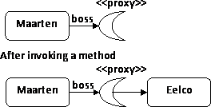
Proxy Object
An object proxy is just a way to avoid retrieving an object until you need it.
The Proxy class is generated at runtime and it extends the original entity class.
Uses Proxy objects for entities is for to allow lazy loading.
When accessing basic properties on the Proxy, it simply delegates the call to the original entity.

Slide 34
get() and load() Method
In hibernate, get() and load() are two methods which is used to fetch data for the given identifier.
They both belong to Hibernate session class.
get() method return null: If no row is available in the session cache or the database for the given identifier
load() method throws object not found exception.
// Get Example
User user = (User) session.get(User.class, new Integer(2));
// Load Example
User user = (User) session.load(User.class, new Integer(2));

Slide 35
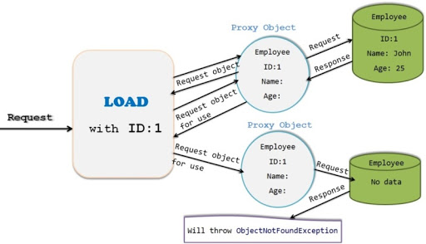
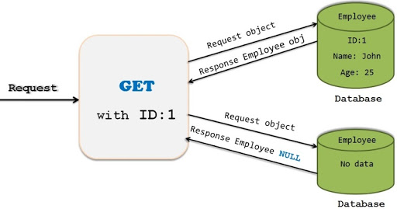
get() and load() Method

Slide 36
Get and Load Method
Difference between get() and load()
Key | get() | load()
Basic | It is used to fetch data from the database for the given identifier | It is also used to fetch data from the database for the given identifier
Null Object | It object not found for the given identifier then it will return null object | It will throw object not found exception
Lazy or Eager loading | It returns fully initialized object so this method eager load the object | It always returns proxy object so this method is lazy load the object
Performance | It is slower than load() because it return fully initialized object which impact the performance of the application | It is slightly faster.
Use Case | If you are not sure that object exist then use get() method | If you are sure that object exist then use load() method

Slide 37
Summary
Queries Introduction
Native Query
Hibernate Query Language
Hibernate Named Query
Proxy Object
get() vs load() method
Notes:
Overview: What is hibernate & high level architecture

Slide 38

Thank you
38

